Slide 1
Assistive Pill Counter
Using ESP32
Akshaya singam 1571633

Slide 2
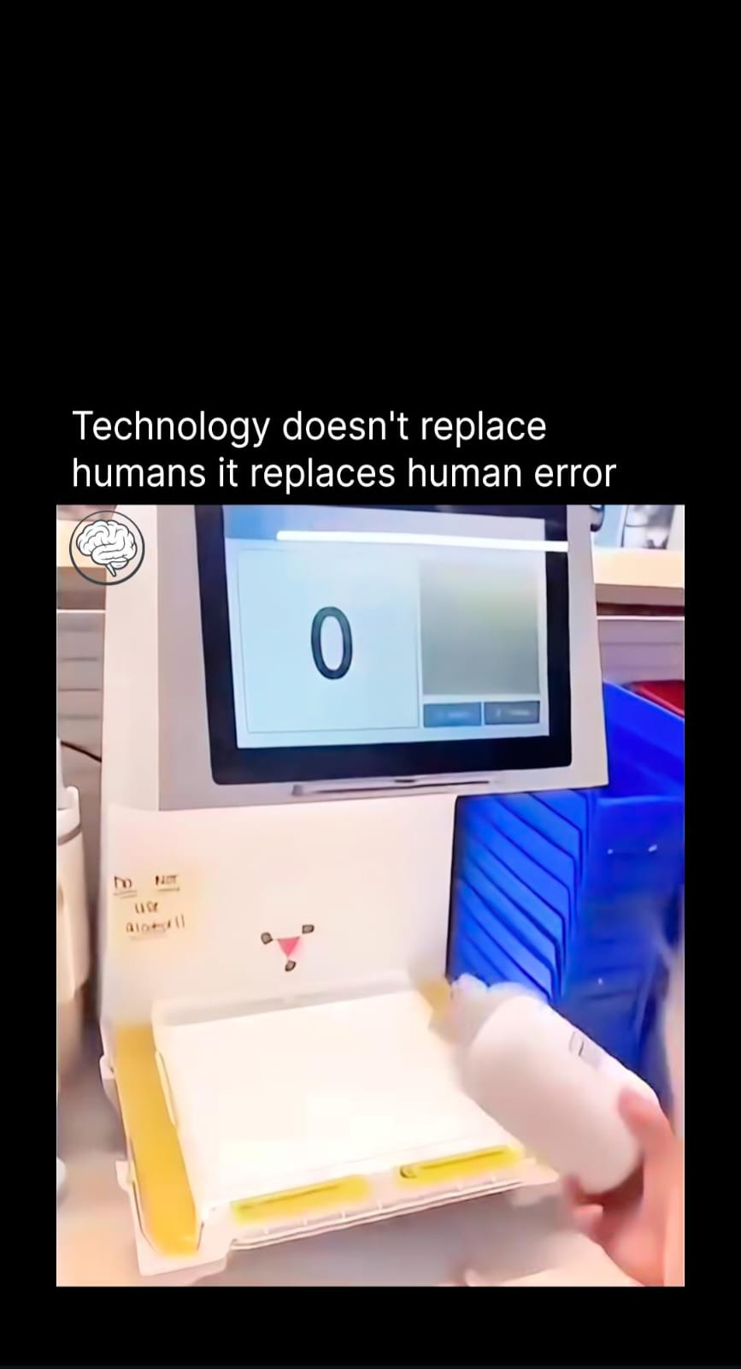
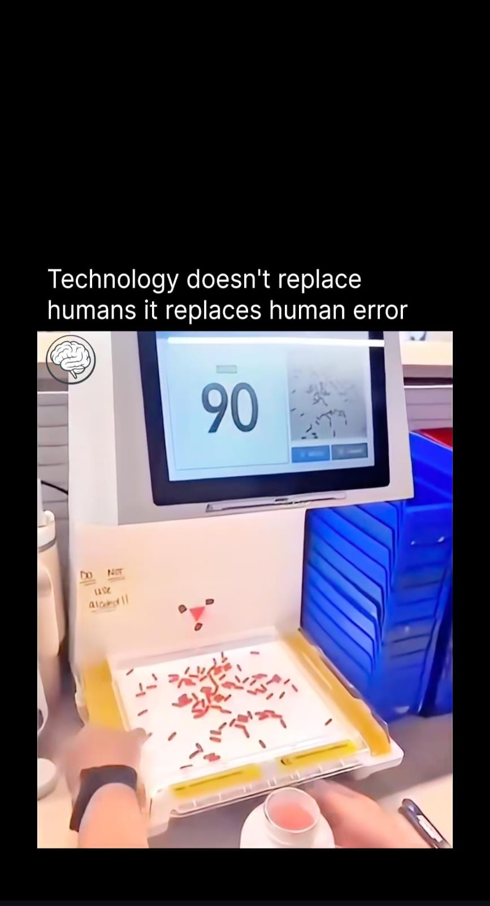
MOTIVATION
Manual pill counting problems:
Time-consuming
Human errors
Not scalable
Difficult for elderly / pharmacies
Goal: Automatically detect and count pills using
a low-cost embedded device.
Reference: Instagram

Slide 3

Project Objectives
Capture images using ESP32-CAM /Mobile
Detect pills using Edge Impulse ML model
Count multiple pills in a single image
Display results through a web browser
Run completely on-device (Edge AI)

Slide 4
Technologies used :
Hardware
ESP32-CAM (AI Thinker)
OV2640 Camera
Machine Learning
FOMO Object Detection
Quantized INT8 model
Software
Edge Impulse
Arduino Framework
PlatformIO
ESPAsyncWebServer
For mobile capture, Python,Flask server

Slide 5
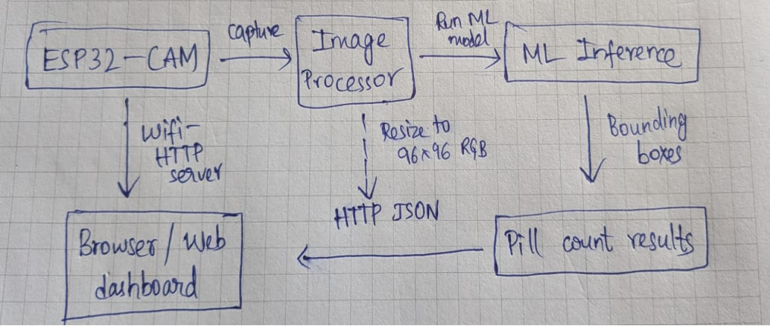
System Architecture (High Level)

Slide 6
01
02
03
04
Hardware Layer
Image Processing Layer
Application & Control Layer
Web Interface Layer
This layer is responsible for capturing raw visual data from the environment. The camera captures JPEG frames and stores them in the ESP32 framebuffer (PSRAM). The ESP32 also integrates Wi-Fi for communication and web server support.
This layer provides user access through a web browser.
“Capture” button
Display of latest captured image
Display of pill count
Live refresh via JavaScript
This layer manages system logic and coordination
Image acquisition
Pre processing pipeline
Machine Learning Inference
Post-processing

Slide 7
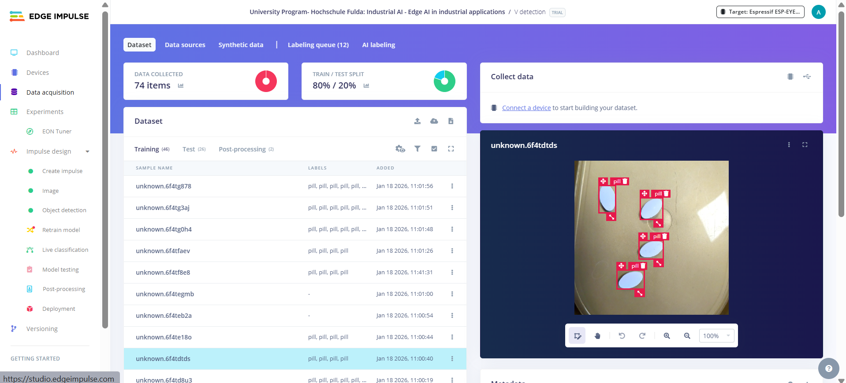
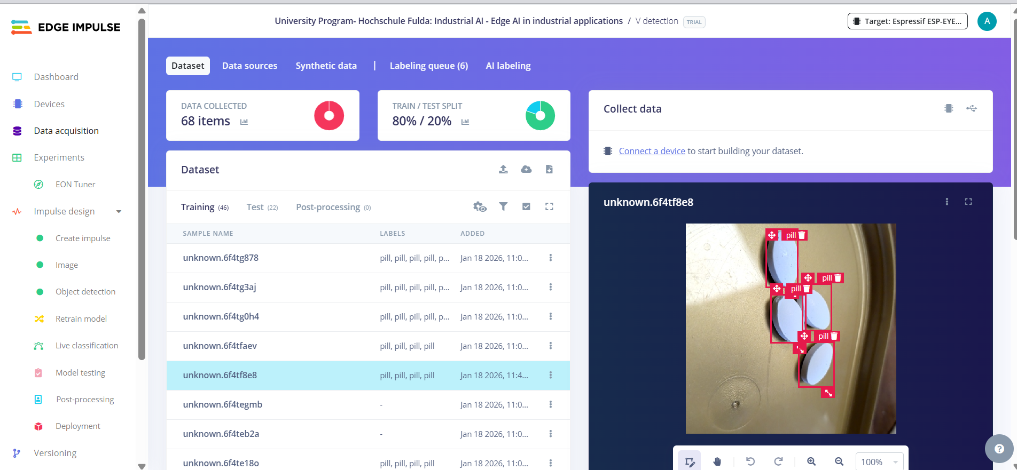
Edge Impulse Workflow
Image data collection
Image labeling (pill bounding boxes)
DSP block (Image – RGB)
Object Detection (FOMO)
Model training & evaluation
Arduino library deployment

Slide 8
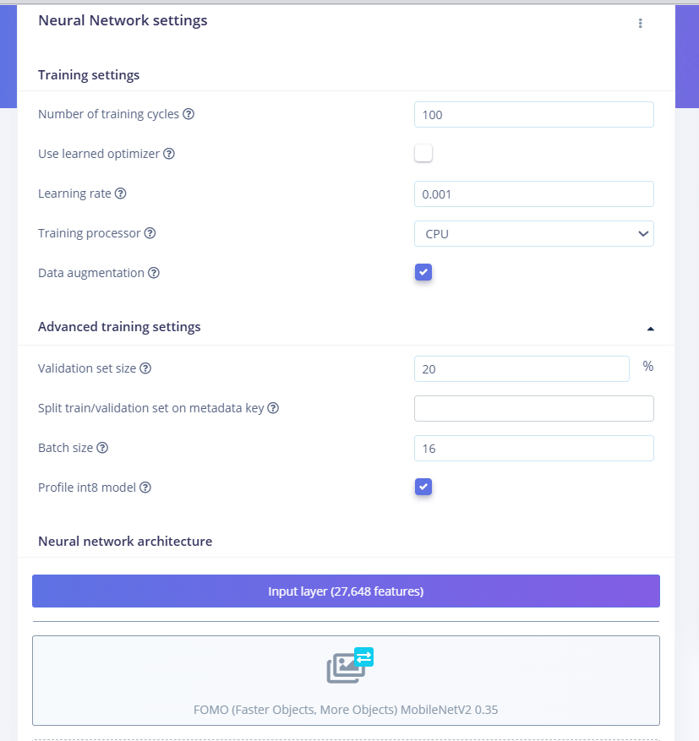
Model Configuration
Model type: FOMO (Fast Objects, More Objects)
Input size: 96 × 96 × 3 (RGB)
Output: Bounding boxes
Threshold: 0.6
Quantization: INT8
Inference engine: TensorFlow Lite Micro

Slide 9
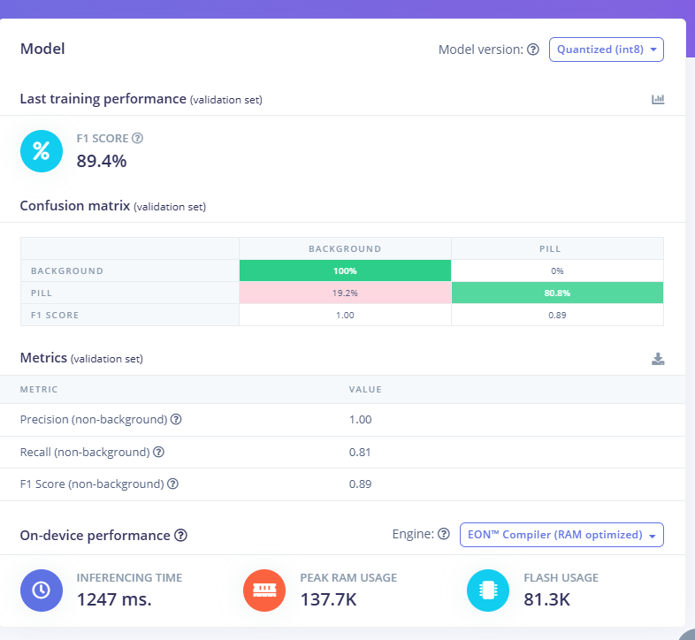
Training Performance
F1 Score: ~89%
Precision: ~1.00
Recall: ~0.81
Validation split: 20%

Slide 10
On-Device Performance
Camera →
JPEG Image → RGB Conversion
→ Resize to 96×96
→ Edge Impulse Model
→ Bounding Boxes
→ Pill Count
→ Web UI
Entire pipeline runs on ESP32
No cloud dependency
Inference time: ~1.2 seconds
RAM usage: ~138 KB
Flash usage: ~81 KB
Runs fully on ESP32-CAM

Slide 11
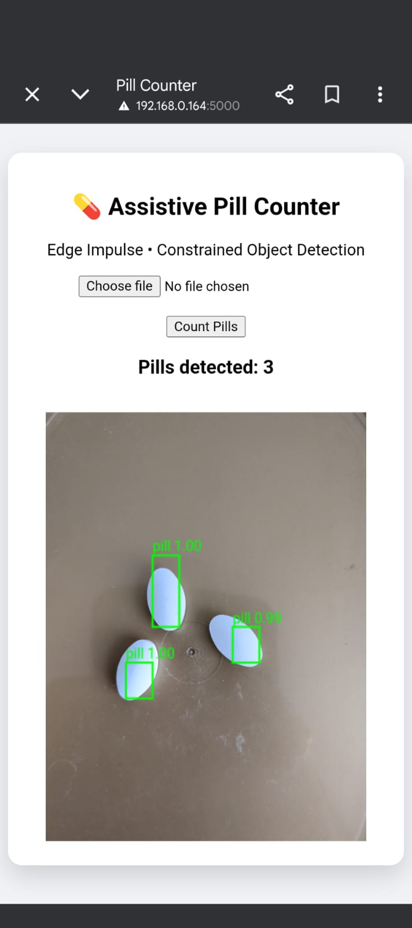
Web inference
Features:
Capture button
Live image display
Pill count display
Runs in any browser
Endpoints:
/ → UI
/capture → ML inference
/image → Captured image

Slide 12
Challenged faced
Solutions Implemented
Limited RAM on ESP32
Image format conversion (JPEG → RGB) Resize & aspect ratio distortion
Preprocessing mismatch between ESP32 and Edge Impulse Studio
Lighting sensitivity ,Image quality differences
Model generalization
Used PSRAM for image buffers, Avoided dynamic memory where possible
Reduced input resolution to 96×96
Tried to match preprocessing with Edge Impulse Studio
Threshold tuning for embedded inference
Quantized model deployment

Slide 13
Python Server Implementation
Mobile captures image
Flask server receives image
Edge Impulse Linux SDK handles preprocessing
Correct resize (fit-shortest),Center cropping,RGB conversion,Normalization
Accurate bounding box detection
Easier debugging and validation
ESP32-CAM Implementation
Captures image on-device
JPEG → RGB conversion
Manual preprocessing aligned with EI DSP
Quantized inference using TensorFlow Lite Micro
Fully offline, real-time Edge AI

Slide 14
Medical safety concerns
Acknowledged risks
False positives / false negatives
Lighting and camera variability
Similar-looking pills
Mitigation strategies (design-level)
Controlled environment assumption
Single-pill-type usage
Human-in-the-loop verification
Confidence thresholds
📌 Human confirmation is required — the system assists, not decides.

Slide 15
Scope & Limitations
Future Enhancements
Assumes one pill type at a time
Designed for controlled lighting and background
Not intended for diagnostic or clinical use
Requires human verification
Demonstrates feasibility of Edge AI-based pill counting
Multi-pill classification
Dataset expansion
Confidence-based warnings
Audit logging
Integration with pharmacy systems
Compliance with medical device standards

Slide 16
Medical is a minefield
Developed a low-cost Edge AI–based pill counter using ESP32-CAM
Achieved on-device object detection with optimized preprocessing
Validated results through Python and Edge Impulse Studio
Demonstrated practical challenges of embedded ML deployment
Positioned as an assistive, non-clinical proof of concept

Slide 17
Thank you!

